Slide 1
IMAGE SIMILARITY SEARCH
By Uzma Usmani

Slide 2
agenda
What is Image?
Feature Extraction of Image
Image Similarity Search
How Image Similarity Search works
Similarity Calculation
Flowchart
Image Retrieval & Ranking
Applications
Use Case
Conclusion

Slide 3
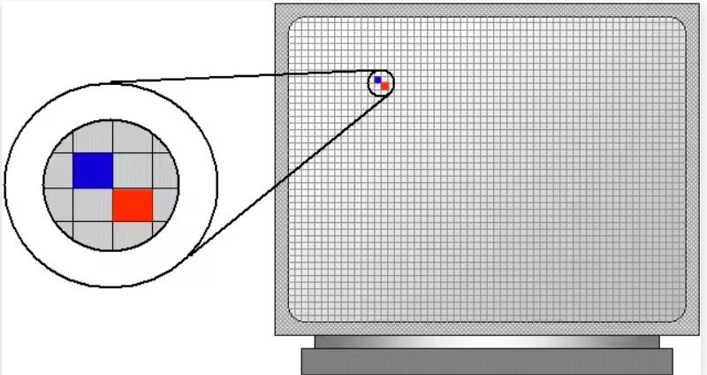
What is Image?
Made up of pixels
Images can be stored in various formats, such as JPEG, PNG, BMP, and others.
Each of these RGB values ranges from 0 to 255.

Slide 4
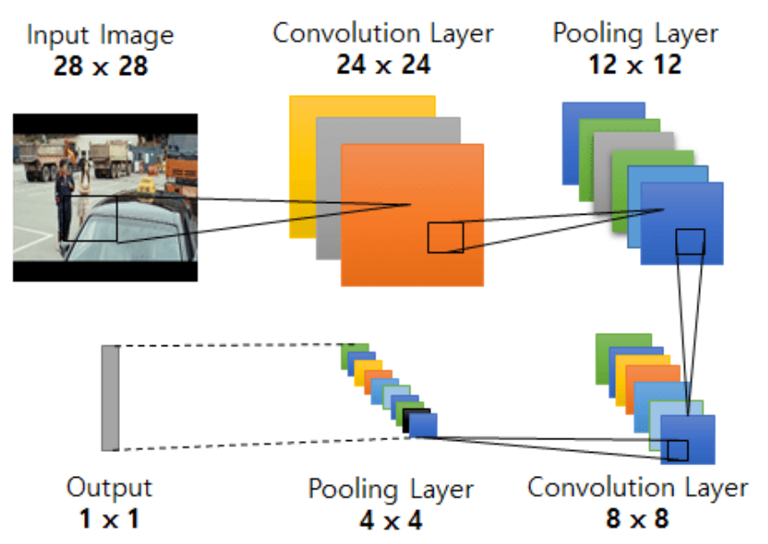
Feature extraction on image
Feature Extraction: Helps computers recognize key parts of an image, similar to how humans identify features in a photo.
Filters (Kernels): Small windows (e.g., 3x3 pixels) scan the image to detect features.
Sliding the Filter: Moves across the image to cover every part.
Detecting Features: Filters identify specific elements like edges or textures.
Feature Map: A new grid showing where and how strong features are detected.
CNNs: Convolutional Neural Networks extract patterns (edges, textures, shapes) from images.
Feature Vector: A numerical summary representing key characteristics of the image.

Slide 5
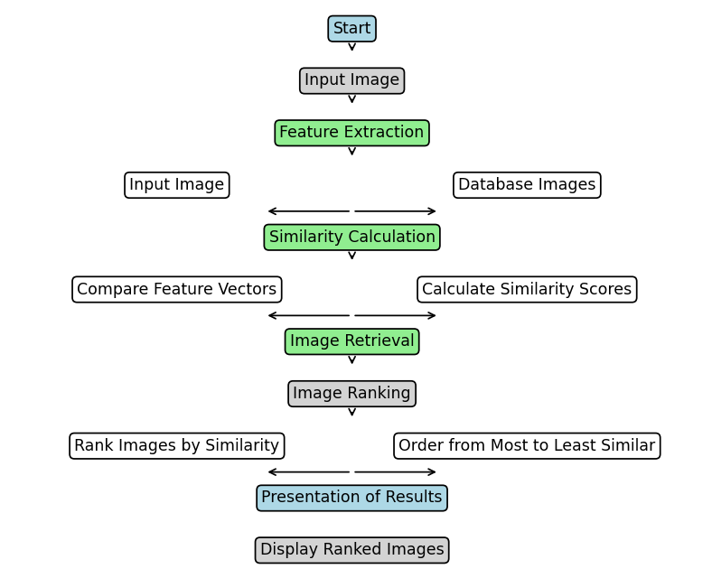
flowchart

Slide 6
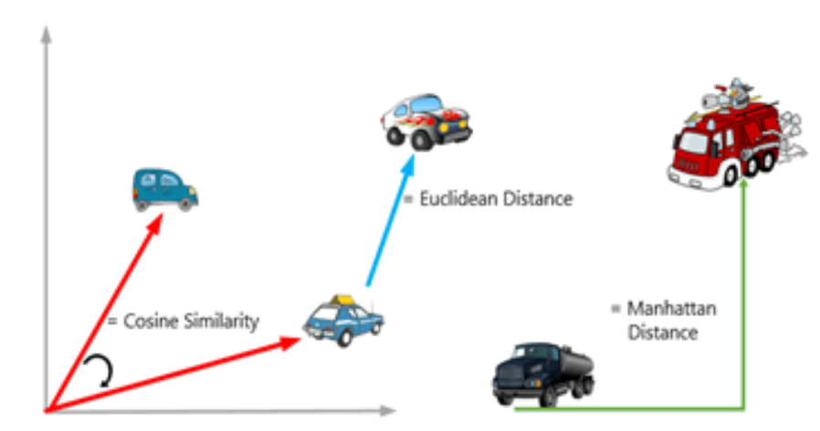
Similarity calculation
Euclidean Distance
Cosine Similarity

Slide 7

applications
E-Commerce and Retail
Example: Amazon
Social Media Platforms
Example: Facebook, Instagram
Medical Imaging
Example: Radiology systems for X-rays, MRIs,
CT scans
Fashion and Design
Example: Fashion apps for finding similar clothing items
Art and Cultural Heritage
Example: Museum and art databases
Surveillance and Security
Example: Security systems with facial recognition
Automotive Industry
Example: Autonomous vehicles for object and road sign recognition

Slide 8
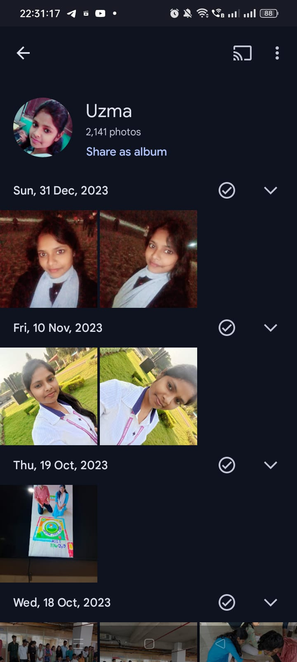
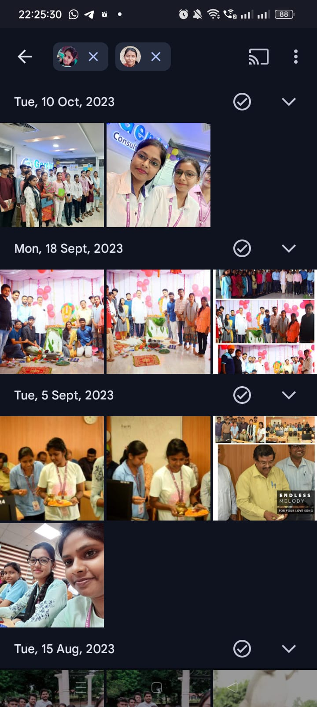
Use case
Differentiating People with Google Photos
Automatic Face Grouping
Facial Feature Extraction

Slide 9
Thank you

